Slide 1
Amex – Next Gen Authorization Blueprint
POV on next generation authorization ecosystem

Slide 2
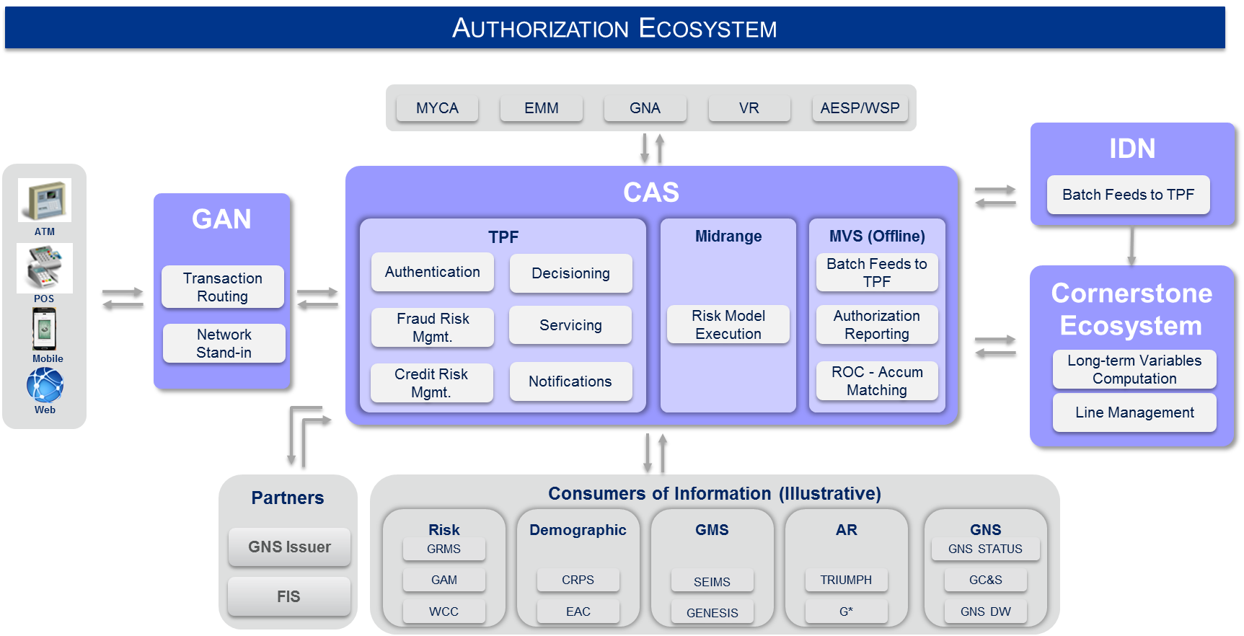
The authorization landscape is evolving - This is the best time to assess the future direction
External Industry Factors
Evolving Capabilities
Instant Offer Fulfilment
Loan at POS
Pay by Points
Evolving Technologies
Machine Learning
Distributed Architecture
Open Source Solutions
Internal Factors
Maturing platforms within Amex
CAS – Midrange platform
Cornerstone Ecosystem
Operational Opportunities
Time to market
System flexibility
Total Cost of Ownership
Evolving business needs
Commercial exposure enrichment
Authorizations for non-card products
A principled approach is required to..
Define the boundaries of authorizations and roles of participating platforms
Build a roadmap for future capabilities

Slide 3
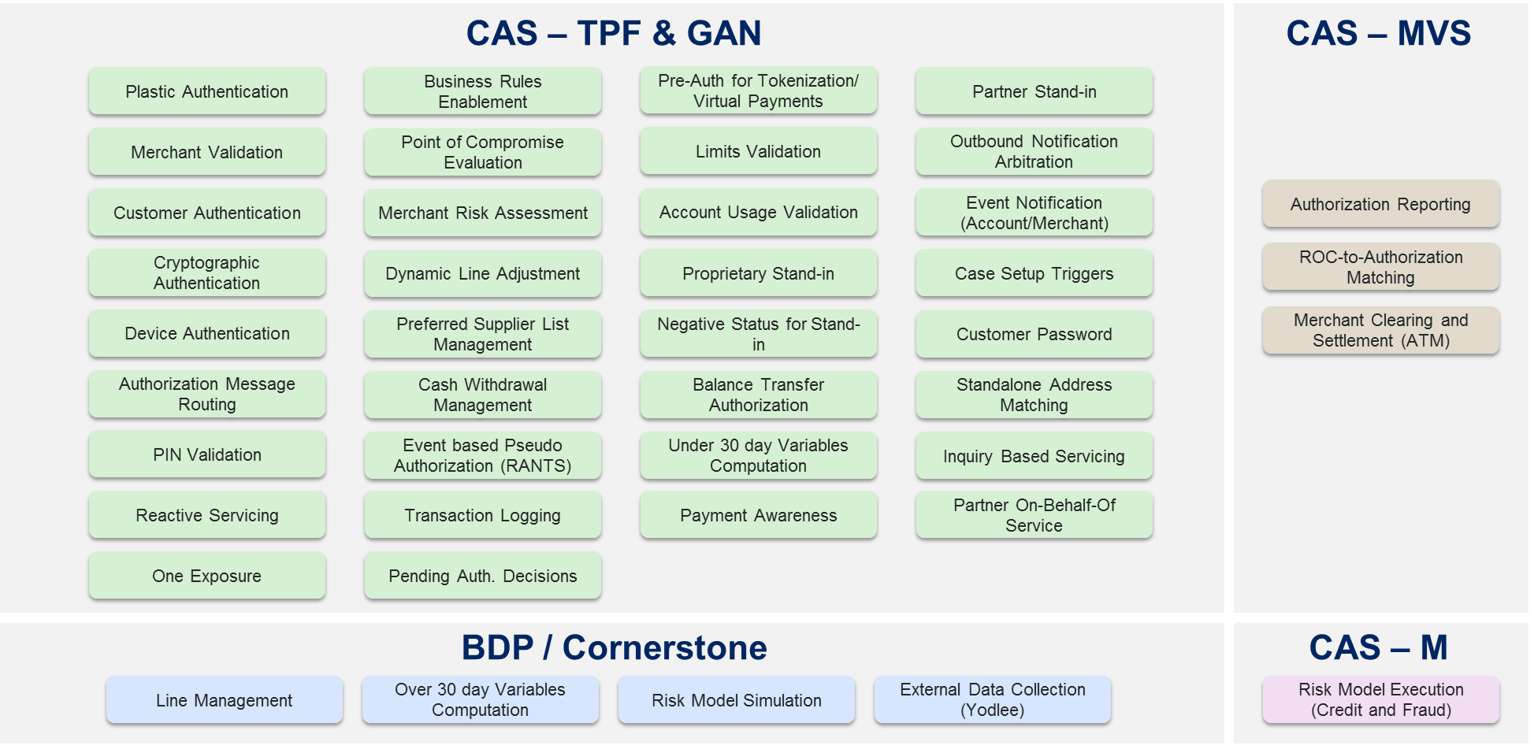
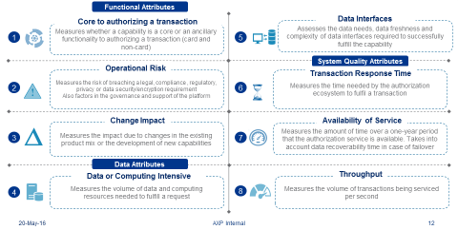
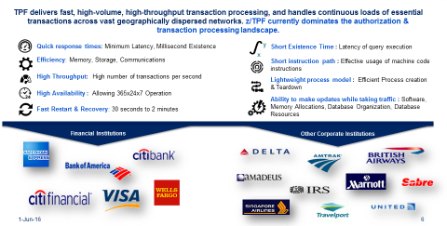
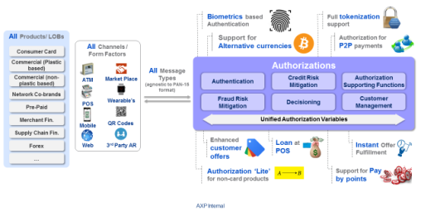
In this exercise, WE worked with business and technology partners to assess the current state and identify needs for the future
ü
ü
Authorization Capability Placement Validation
ü
Industry Benchmarking
ü
Future Needs from Authorization
Current State Assessment
Commercial Risk Mgmt.
Modelling
Commercial Lending
Fraud
Cornerstone & Risk Technologies
Dan Massoni
Amit Soni
Chin H. Khor
Sastry Durvasala
Sandeep Bose
Misha D
Rajat Jain
Lei Chan
Pat Herman
Kevin Murray
Rajiv Prakash
Sankara N
Kaustav Das
Pradeep VR
Gorav Bindra
Licenia Rojas
Jayatu Chaudhury
Carl Larkin
Swatee Singh
Aparna S.
Michelle Beckman
Harish Naik
World Services
Zhong Jian Xia
Vinod Yadav
Sudhakar Gopal
RIM Innovation
GNB
Global Customer Mgmt.
Toby J Mason
Compliance
Amber Gupta
Mike La Rooy
Seana Pitt
Shen Chang
Ray Didonato
Sanjay G
Thomas E Taris
Tamara Benett
Gillen Clements
Nerses Kazarian
May Chan

Slide 4












We assessed solutions leveraged by the industry for authorizations and high volume transaction processing
Despite challenges, disruptive fintech capabilities emerging, and competitors evaluating open source based solutions, z/TPF remains one of the strongest players in the authorizations space.
z/TPF dominates the current authorizations space.
Large set of current and new feature offerings
High usage across global companies
New age firms and Fintech companies are using disrupting technologies for high volume transaction processing
Most fintech companies are only looking to solve a small piece of the authorization puzzle
Key solution highlights include
In Memory model execution
Cloud hosted high volume processing
Built-in machine learning algorithms
Several large firms have attempted open source based POCs but no equal-sized financial institutions have made a complete migration from the z/TPF platform.
Visa, MasterCard, and the likes remain operative on z/TPF or legacy platforms
Most companies appear to be evaluating long term options to be migrating away from legacy technology

Slide 5


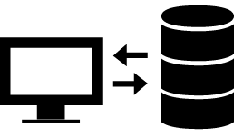



we aligned on six core principles to guide our decisions
Point of sale transactions require sub-second response (400 ms), and very high availability (> 4 9’s)
Most recent data is required to make optimal authorization and risk management decisions
Servicing authorizations requests require real-time data interfacing with other systems
Instant & short-term variables will be calculated on core platform and long range historical variables will be sourced from supporting platforms
Authorizations require superior platform governance, operating model, dedicated infrastructure and support
Business benefits and TCO should be key considerations for making architectural decisions

Slide 6
Based on discussions with partners, industry insights and guiding principles we arrived at four key recommendations
1
2
3
4
Retain core authorization capabilities on z/TPF. Simplify platform for enhanced Time to market
Move authorization supporting capabilities to CAS – M in phased manner
Leverage Cornerstone Ecosystem for simplification of Line related customer management functions
Invest in authorizations to support growing commercial and non-card business needs
z/TPF continues to be the ‘best in class’ platform for high volume transaction processing. No comparable institution is migrating out of z/TPF
Fulfills core authorization and customer management functions (e.g. reactive services reliant on authorization workflows and latest risk variables & scores) effectively in real-time (400 ms)
Emerging platforms not yet ready for processing at 5 9’s availability
Testing Automation will reduce Time-to-Market significantly
Significant non-authorization volume can be moved off TPF enabling de-risking of TPF
Advent of CAS-M will lead to over $10 million in saves in the next three years
With adequate investment , CAS-M is poised to be the strategic solution for CAS Stand-in (for risk assessment, plastic authentication, address matching, EMV crypto, SafeKey, ATM etc.) for both proprietary and partner customers
Several global institutions and Fintech firms have invested in open source solutions like CAS-M to complement their legacy platforms
Cornerstone Ecosystem is evolving rapidly and several business lines are investing in it for their future capabilities
Several complementary functions to authorization are being built in the ecosystem (e.g. DCEL)
Cornerstone Ecosystem is the POA platform for Line Decisions
Enhanced exposure calculations for Commercial line of business needed
Support for universal message formats: agnostic to PAN15 construct
Authorization protocols and workflows to support non-card products

Slide 7

In the POA, each platform will play a definitive role in the authorization ecosystem
POA Authorization Eco-System
Interfacing/Service request systems (illustrative)
MYCA
WSP
CSP
CLP
GAN
CAS
Cornerstone Ecosystem
Channels and Form factors
TPF
Midrange
Transaction Routing
Transaction Formatting and validation
Auth. Stand-in (Stand-in in case CAS systems; TPF and Midrange, are unreachable or unable to provide decision in stipulated time)
Core Authorization Functions
Customer management functions reliant on authorization workflows and freshest risk assessment data (reactive underwriting, CIUMC, notification arbitration etc.)
Authorization supporting functions requiring freshest data and real-time response
CAS Stand-in (for services such as risk assessment, plastic authentication, address matching, EMV crypto, SafeKey, ATM, Online PIN, Tokenization etc.)
Data validation, formatting and real time exchange with TPF
Complement CAS decisions with pre-computed values
Historical data rollups, offline calculation
Line-related customer management functions
Data exchange with permissible latency
GAN
CAS-TPF
CAS-Midrange
Cornerstone

Slide 8
Capabilities deep dives

Slide 9
Based on evaluation, Most Authorization capabilities were determined to be right - platformed
CAS Ecosystem (TPF, Midrange, MVS)
Cornerstone Ecosystem
Core Authorization
(will continue to be hosted on TPF)
Supporting Functions
(capabilities on migration path to CAS – M from CAS – MVS)
(Capabilities on migration path to Cornerstone Ecosystem)
Customer Authentication
Cryptographic Authentication
Device Authentication
Event Based Pseudo Authorization (RANTS)
Merchant Clearing and Settlement (ATM)
ROC-to-Authorization Matching
Line Management
Merchant Validation
Plastic Authentication
PIN Validation
Point of Compromise Evaluation
(Capabilities evaluated for re-hosting on other platforms)
Over 30 day variable computation
Merchant Risk Assessment
Business Rules Enablement
Cash Withdrawal policy validation
One Exposure
Account Usage Validation (CIUMC)
Event Notification (Account/Merchant)
Risk Model Simulation
Negative Status for Stand-in
Dynamic Line Adjustment
Pre-Auth for Tokenization
Limits Validation
Case Setup Triggers
Authorization Reporting
External Data Collection (Yodlee)
Balance Transfer Authorizations
Preferred Supplier List validations
Auth. Message Routing
Standalone Address Matching
Reactive Servicing
Partner Stand-In
Transaction Logging
Partner On-Behalf-Of Service
Outbound Notification Arbitration
Inquiry Based Servicing
Proprietary Stand-In Authorizations
Under 30 day variable computation
Pending Auth. Decisions
Customer Password
Risk Model Execution (Credit & Fraud)
Payment Awareness

Slide 10
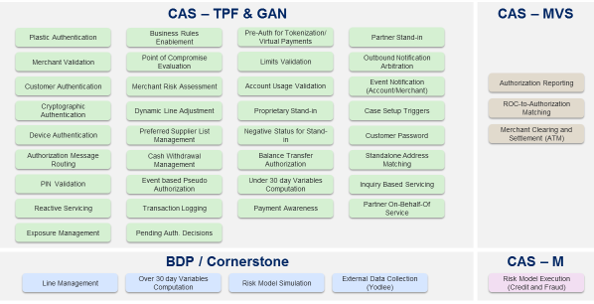



Capabilities were evaluated for expected business benefit from migration and scored against the guardrails of our simple, lean EVALUATION framework
Capabilities supported by Authorizations
Evaluation
Answered how far the capabilities are away from being right-platformed
Answered what is the incremental benefit of moving a capability
Guardrails and Guiding Principles
Business Benefit Analysis
Synthesis
Hypothesis for Migration

Slide 11



Several customer management functions are prime candidates for migration to CAS – M in short to medium term
Case Setup Triggers
Standalone Address Matching
Outbound Notification Arbitration
Inquiry Based Servicing
Customer Password
Event Notification (Account/Merchant)
Current State
Key Considerations/ Principles
Recommendations
Volume: 15MM/day
SLA: 0-3 seconds
Immediate (2016)
Should continue to stay on TPF as TI cost saves do not justify migration
Short to Medium Term
Inquiry Based Servicing: Migrate to CAS-M to enable higher availability for servicing
Outbound Notification Arbitration – Retain on TPF as no TI benefit of migration. In the long term assess for migration if another enterprise arbitration platform is developed
Event Notification: Migrate to CAS-M
Standalone Address Matching: Short term retain on TPF. For long term assess migration if an enterprise matching engine is developed
Customer Password: Review capability with enterprise architecture to determine appropriate platform strategy
Case Setup Triggers: Message preparation function done by MACS should be assessed for migration to CAS – M, while retaining the DAC rules on TPF
Post facto functionality, not core to authorizations
Requires near real-time response and very high availability
Migration will lead to increased availability for servicing functions, but TI cost saves of migration are not significant
CAS-M will have all relevant data from TPF in Real Time
CAS-M is targeted at 5 9's availability
CAS-M has already built 4 interfaces that it will expose and over 10 new interfaces are targeted by Q4 2016.
Ancillary functions built on TPF to enable inquiries and notification functions
Interfaces with several servicing and fulfillment systems such as MYCA, CSP , WSP, WCC, Smart Swipe and GCS
Significant volume of transactions , but requires much fewer compute instructions per transaction

Slide 12
CDSS, TSR Models are core to authorizations and should continue on CAS. Opportunity for line reduction process to be integrated with enterprise line management strategy
Risk Model Execution (Credit and Fraud)
Current State
Key Considerations/ Principles
Recommendations
CDSS, TSR Models
Line Reduction Model
CDSS, TSR Models
Should continue to stay on CAS - Midrange
Line Reduction Model
In short term, should continue to stay on CAS
In long term, should be assessed for integration with enterprise line management strategy on Cornerstone ecosystem
Cornerstone Ecosystem should build interface with fulfillment system (GRF) to support the functionality
CDSS, TSR Models
Execution on authorization path: requires sub-second response time & very high availability
Computing heavy & requires real-time data exchange with TPF
Re-hosting would not yield any incremental benefit
Line Reduction Model
Not core to authorization
Low volume functionality with non-significant impact on MIPS
Re-hosting would not yield significant cost saves
Re-hosting will require target systems to interface with fulfillment systems
Volume: >30 MM / day
SLA: 4 millisecond
Run on Gradient Boosting Machine (GBM) on CAS – Midrange platform
Run at very high efficiency
Proactive line reduction; recommends line reduction on CM line
Recommendations sent to downstream systems for fulfillment

Slide 13
Opportunity to re-architect Payment awareness offline on cas – m leveraging POA PAYMENT SOLUTION (Payment services hub)
Payment Awareness
Current State
Key Considerations/ Principles
Recommendations
Volume: 4 to 6 MM / day
SLA: 400 ms
Payment Awareness data is critical data for calculating exposures
Payment Awareness is SOR for certain electronic payments
Incremental benefit in migrating PA offline from mainframe (high cost) to midrange (low cost)
CAS-M proven for streaming data to TPF, can exchange data with TPF near real time
CAS-M positioned to leverage payments POA solution (Payments servicing hub) simplifying payments data sourcing
CAS-M can build payment variables using additional payment data (0 – 6 months) to mitigate current limitations for GCP
Payment Awareness online should continue to stay on TPF (short and long term)
PA offline should be re-architected and migrated to CAS - M to leverage POA payments solution
Payment Awareness (PA) comprises of PA Online Database (on TPF), PA Offline (on MVS)
Payment awareness sources data from over 6 different payment applications in batch and real-time
PA online database maintains the latest payment data and feeds One Exposure for computing exposure
PA computes payment variables based on limited payments data which is sub-optimal for GCP

Slide 14
CAS – M will consolidate payment data from multiple sources and stream into tpf in real time
IPA
ATM
CLP
POS
EMM
PSH
Solace
CAS - TPF
IDN
CAS - M
CAS - M
Batch
RT
Payment Awareness Online
RT
iCLIC
PA Front end
PA Back end
One Exposure
Cornerstone
Reconcile payments
Standardize payment formats
Compute payment variables
Publish Data
Reporting

Slide 15
Reactive services require high availability and instant response and should continue on TPF. Opportunities exist for simplification of certain services
Reactive Servicing
Current State
Key Considerations/ Principles
Recommendations
Volume: ~0.12 MM/day (75% New Accounts/ Upgrades)
SLA: < 3 sec
Short Term
Retain on TPF: Reinstatements, Re-allocation, Member calling service, Ability to pay, LOC enrollments, APR change, Default Tier Reversal
Re-engineer: Harvest DCEL computations from Cornerstone Ecosystem to simplify: Line Increase, Cash Line increase
Decommission from CAS (Migrated to BDP as part of line decisions): New Accounts, Upgrades
Post facto functionality, not core to authorizations
Requires near real-time response and high availability
Volumes are insignificant. No incremental benefit in migration
Needs multiple interfaces, latest data to make accurate decisions
If rehosted, interfaces to several servicing & fulfillment systems would have to be built on target platform
Target platform should also provide for a robust rules engine like DAC
Consists of over 15 different types of servicing requests that utilizes authorization data for decisions
Includes several line related services such as line increase, line reallocations and new accounts
Long Term
As volumes become significant, migrate services not requiring latest data to Cornerstone Ecosystem (CS/E)
Ability to Pay logic to be localized in CS/E and data to be consumed by other applications
Re-assess Line increase and Re-allocation services to be integrated with Enterprise Line Management strategy
Traverses a large part of the authorization path to build variables for decision making

Slide 16
CIUMC is equivalent of an authorization request and should continue to stay on tpf
Account Usage Validation (CIUMC)
Current State
Key Considerations/ Principles
Recommendations
Volume: 30 K – 40 K / day
SLA: 400 ms
Execution on authorization path: requires sub-second response time & very high availability
Requires freshest risk assessment data for decision making
Migration would require rebuilding the authorization like process on host platform or redesign CIUMC approval process
No incremental benefit in migrating
CIUMC should continue to be hosted on TPF
Equivalent of an authorization request
Verifies the ability to using the card by evaluating the authorization parameters around authentication, credit and fraud risk assessment

Slide 17
Significant opportunity to rationalize existing reports before re-hosting them on cornerstone ecosystem
Authorization Reporting
Current State
Key Considerations/ Principles
Recommendations
Volume: >400 reports/day (16 GB)
SLA: Batch
Post facto functionality, not core to authorizations
Batch based, data and computing intensive process
In POA, Cornerstone will be SOR for 30+ days of authorization data
Cornerstone is POA for enterprise warehousing platform and reporting is part of its charter
POA state will have significant increase in variables being sent to Cornerstone
Cornerstone will receive data from CAS as part of TPF logs
CAS – MVS generates reports using authorization data received from GAN and TPF
Major opportunity to rationalize current reports and decommission defunct reports
All other reports generation to be migrated to POA Reporting Platform
Reporting categories include Operational, BI and legal reports
Reports are generated daily, weekly, monthly and at the end of the year
Reporting requirements, formats unchanged for a long period

Slide 18
POST Rationalization, all reporting would be owned by Cornerstone Ecosystem
Authorization Reporting
MIS Reports
Legal Reports
BI Reports
Stand-in Reports
Accounting Reports
Operational Reports
GAN Reports
Reports on transaction data such as volumes, referrals
Report for legal purposes (subpoenas etc.)
Statistics based reports for business partners
Reports about stand-ins for GNS partners
Reports for accounting groups and GNS partners based on ATM data
Error data reports for data feeds from other systems
Reports for Merchant Acquirers using GAN data only
CAS - TPF
Real-time Data Feed
CAS - M
POA Reporting Platform
Solace
Authorization Reporting

Slide 19
Thank you

